Slide 1

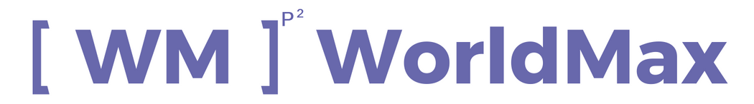
Austen Tech
USING FORMS
&
POWER AUTOMATE TO UPGRADE YOUR CUSTOMER ONBOARDING EXPERIENCE

Slide 2
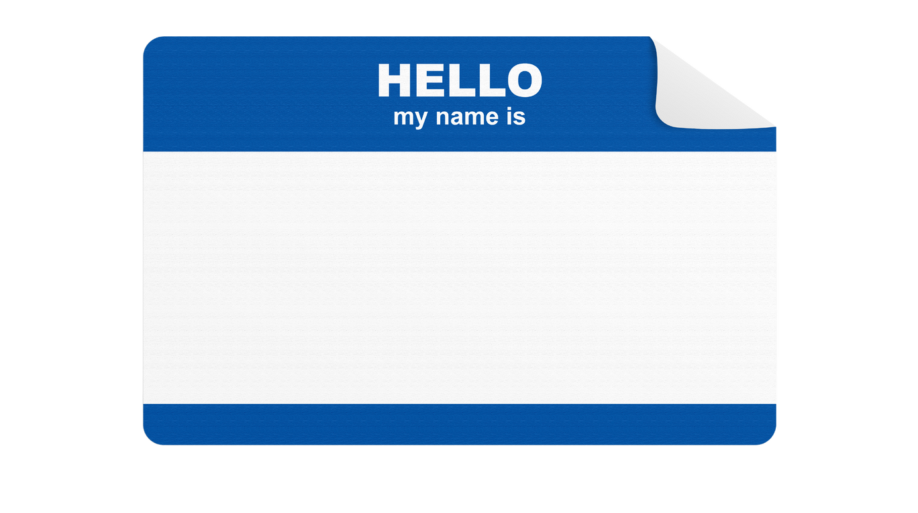
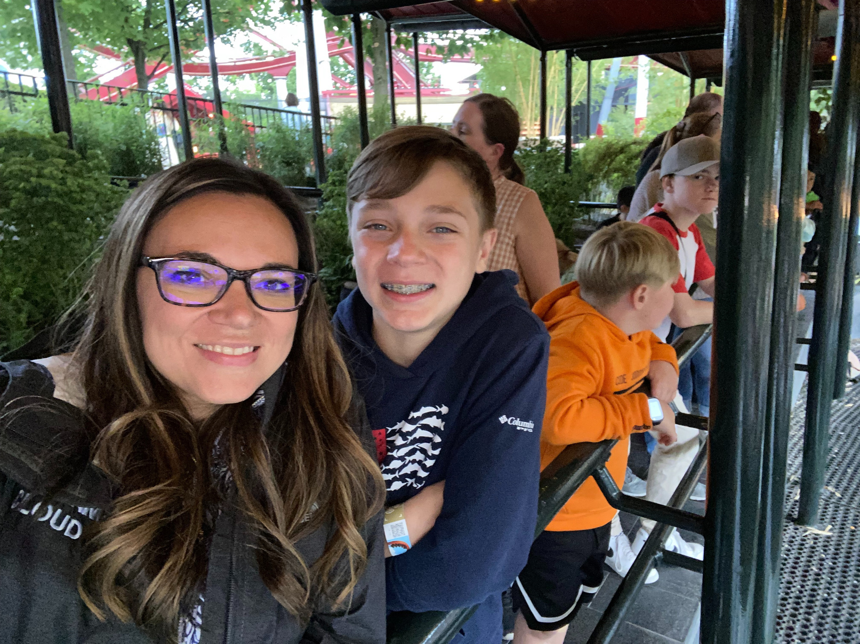

Mary Myers
Located in Bradenton, FL
Football/Golf
Tech industry for 4 years
Chief Maximizer @ WorldMax
I ❤ SMB's

Slide 3


What Is Customer Onboarding?

Slide 4


Problem
Problem
Inefficient
Inaccurate
Inadequate
Business Downfall
First Post Sale Interaction
Negative Impact on Cash Flow
No ability

Slide 5

Solutions
Solution
Microsoft Forms
Power Automate
Dataverse, or CE, or BC, or F&O
Business Success
Seamless professional experience for customer from sales to completion
More time to build customer base and scale
Increased cash flow and less errors.

Slide 6

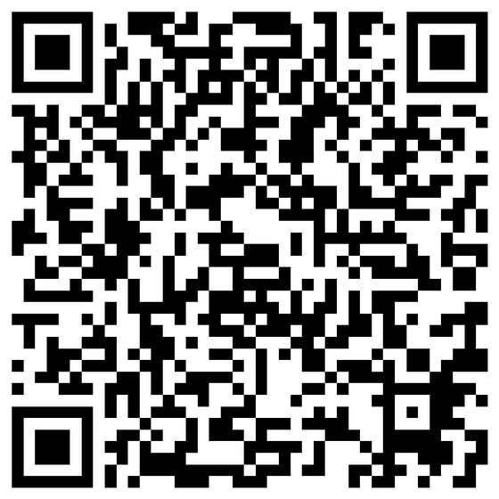
DEMO

Slide 7

Let's Connect
Mary@worldmaxp2.com
Twitter: MaryMyers_WM

